Slide 1
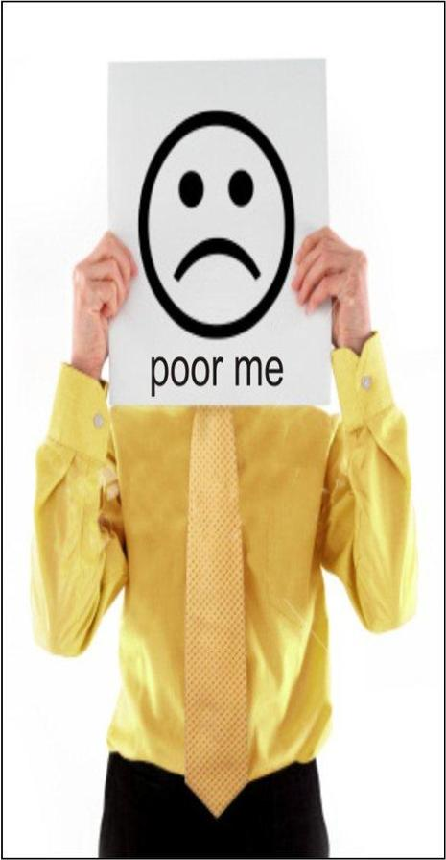
Poor Me
Victim of circumstances, therefore entitled to pity and sympathy. Will go to great lengths to share their suffering; talking and focusing non-stop on all that is wrong with their life and situation.
Impact of behavior:
Preoccupied with his own circumstances, which may be irritating to others.
Feels justified in their complaining and looks for others to join their “pity party.”
Loves the sympathy and pity they receive from others. Irritated if they don’t get it.
© 2014 - David Emerald - All Rights Reserved – www.powerofTED.com

Slide 2
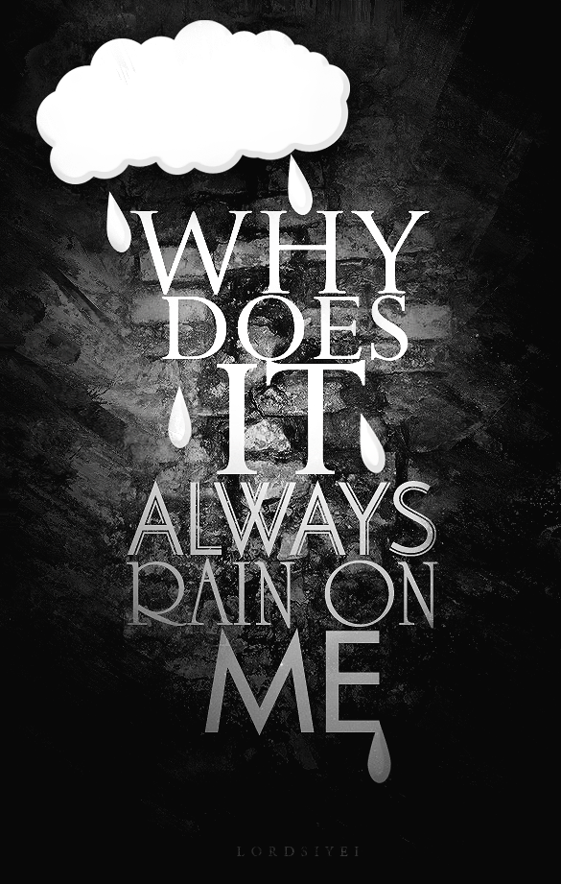
Why Me?
Victim to life in general because others are luckier, smarter, prettier, healthier, etc., so therefore entitled to their anger, blame and judgmental attitude.
Results of this behavior:
Often give up---“the quitter” --- because there’s no reason to work hard and dream. Could also be named “the whiner.”
Often say, “It’s not my fault” or “Whatever” or “What did you expect?”
A constant and nagging sense of unfullfilment running in the back ground of their consciousness.
© 2013 - David Emerald - All Rights Reserved – www.powerofTED.com

Slide 3
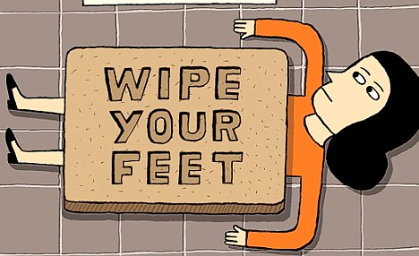
Doormat
Victim to being taken advantage of, pleasing everyone else. Submits to authority and needs of others and therefore feels entitled to their approval and love.
Results of this behavior:
Often overworked because they take on too many duties.
Can attract Persecutors who are willing and able to abuse them.
Very poor boundaries and feel it is their duty to do what everyone else wants.
Their feeling of being victimized and at the mercy of others distinguishes them from Rescuers who initiate being overly helpful. (Victim identity is at the root of both.)
© 2014- David Emerald - All Rights Reserved – www.powerofTED.com

Slide 4
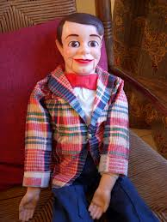
Dummy
Victim to perceived lack of knowledge or intelligence and therefore entitled to being uninformed, helpless and blameless.
Results of this behavior:
May not ask for help because they fear they won’t understand.
Often overwhelmed because they feel handicapped and helpless.
When receiving information or direction, their anxiety may be high because they have convinced themselves others won’t understand them.
Feel anything they do will be wrong or ineffective.
© 2014 - David Emerald - All Rights Reserved – www.powerofTED.com

Slide 5
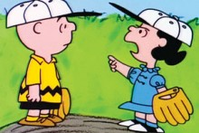
Chameleon
Victim to others influence and
pressure, therefore entitled to not
having a choice about their
boundaries or what they want.
Results of behavior:
Fear making mistakes and knowing what others want.
“Just tell me who you want me to be and what you want from me.”
May ask for constant direction from others.
Relinquishes their own creativity and sense of direction.
Submitting to the influence of others is about their “beingness” rather than their intelligence or knowledge.
© 2014 - David Emerald - All Rights Reserved – www.powerofTED.com

Slide 6
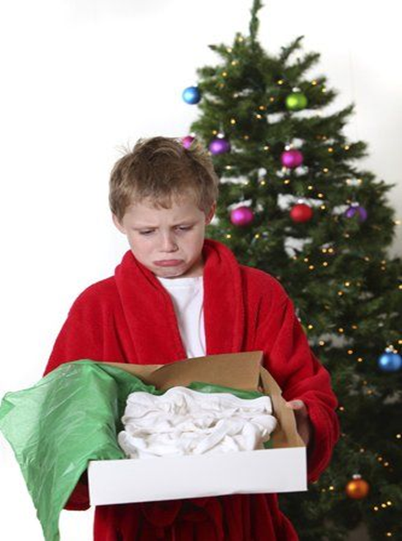
Scarcity
Victim to lack, deficiency and wanting therefore entitled to charity, special favors and rewards.
Results of behavior:
Blames others who are better off than they.
Not happy or grateful for what generosity they do receive.
Others feel victimized by their constant wanting and demanding behavior and attitude.
Not willing to work hard for to get ahead.
Feeling of “entitlement” is strong.
© 2014- David Emerald - All Rights Reserved – www.powerofTED.com

